Slide 1

Topic:
Analysis of Revenue Decline in Business

Slide 2
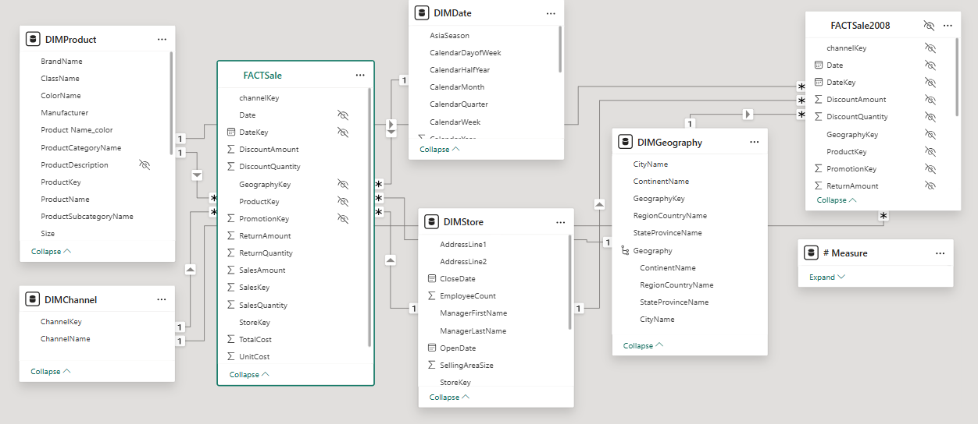
data
Source: Microsoft Data Stories Gallery
Target: Analysis of Revenue Decline in 2008
Number of Transactions: 639,938
Data Model: 1 Fact Table & 5 Dimension Tables (Star Schema)

Slide 3
Company background
Product Category | Product Category
Audio | TV and Video
Cameras and camcorders | Games and Toys
Cell phones | Home Appliances
Computers | Music, Movies and Audio Books
Contoso – A Multinational Company
Timeframe: 2007 – 2008
Markets: Asia, North America, Europe
Distribution Channels: Store, Online, Reseller, Catalog
Electronics Industry: Focused on electronics
Product Range: 8 categories, 32 Subcategory, 629 products

Slide 4
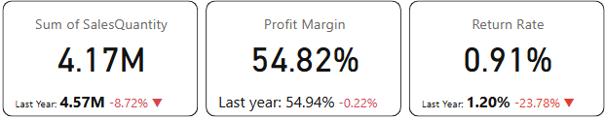
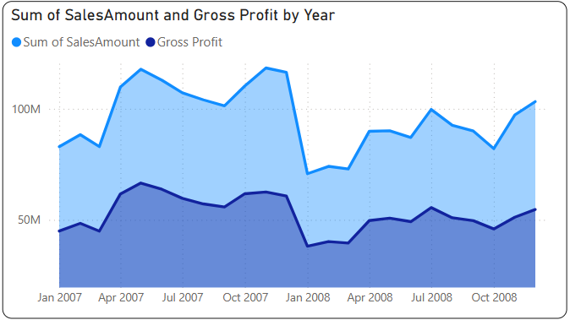
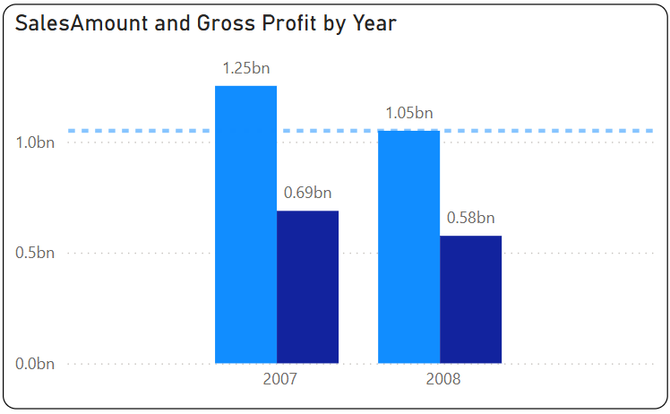
Performance Overview
Revenue and Profit
Revenue & Profit Decline (2008 vs. 2007)
Revenue (2008): $1.05B (-$252M, -16.19%)
Profit: Dropped from $688M to $575M (-16.38%)
The company's revenue and profit tend to fluctuate in the same direction.
Business performance is affected by seasonality, with strong growth in Q2 and Q4 but declines in other quarters.
In 2008, both revenue and profit experienced a significant drop.

Slide 5
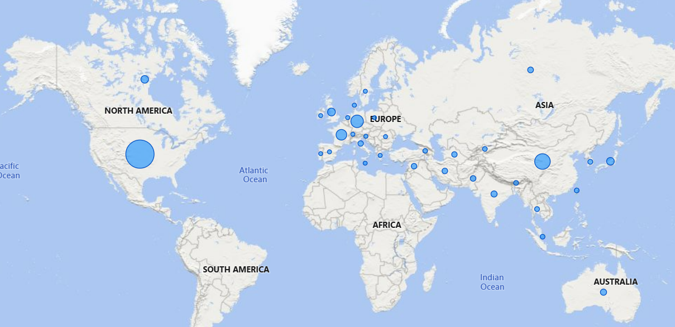
Performance Overview
Geography
North America, Europe, and Asia are the three markets where the company operates.
In 2008:
Asia: $240M (22.95% of total revenue)
Europe: $195M (18.63% of total revenue)
North America: $613M (62% of total revenue)
USA: The largest share, contributing 46% ($592M).

Slide 6
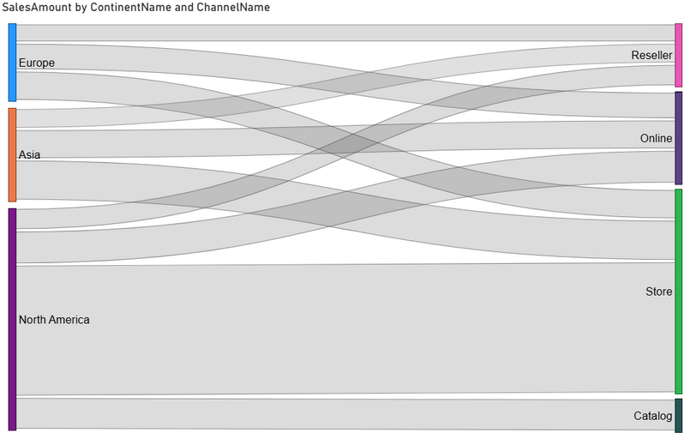
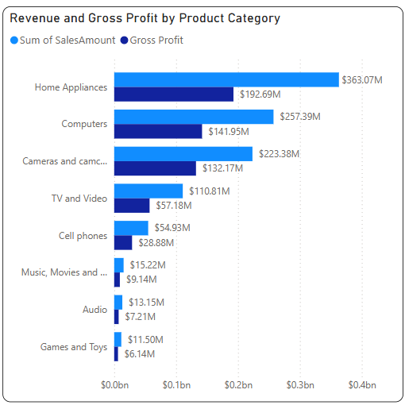
Performance Overview
Channel and Product
Company currently offers 8 products categories, 32 subcategories and 629 products
Top 3 revenue-generating products (80.41% of total revenue in 2008):
Home Appliances: $363M
Computers: $257M
Cameras & Camcorders: $223M
The company currently operates through four channels: Reseller, Online, Store, Catalog
Store is the largest channel, generating $571M in 2008 (54.47% of total revenue), with most sales in the USA
Catalog sold only in USA, contributing $86.96M

Slide 7
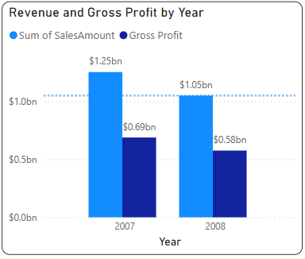
discussion
In 2007, revenue grew well, reaching $1.25B.
However, there was a sharp decline in early 2008.
What caused this drop?

Slide 8
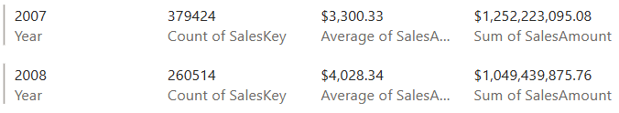
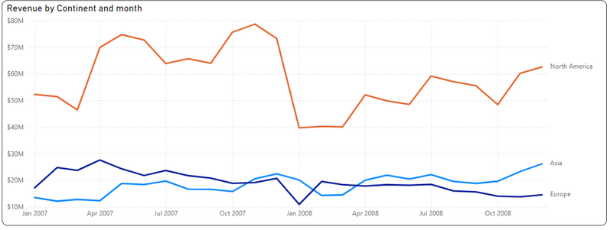
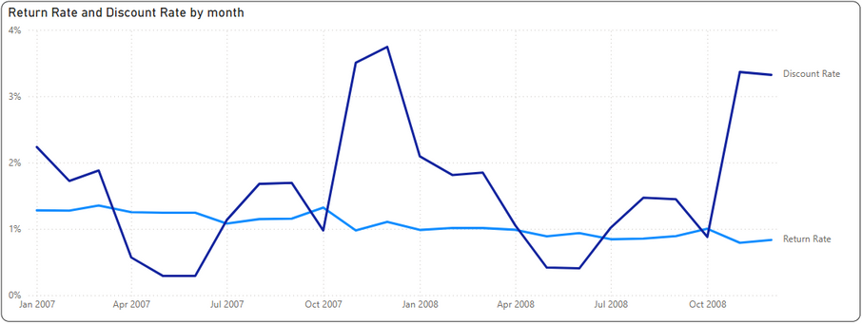

Revenue decline was mainly caused by a sharp drop in order volume.
In 2008, revenue declined by $203M (-16.2%) due to:
Higher average order value: Increased by $728 (+22%), boosting revenue by $189M.
Significant drop in order volume: Decreased by 118K (-31.3%), reducing revenue by $392M.
Conclusion: The main cause of revenue decline was the sharp drop in order volume.
Seasonal trends: Peaks in Q2 & Q4, bottom in Q1.
Revenue decline mainly from North America, while Asia showed steady growth over time.
Conclusion: The decline was largely driven by the 2008-2009 global financial crisis.
Discount Rate: Affected by seasonality, peaking in Q4 and hitting a low in Q2.
Return Rate: Declined steadily over time.
Conclusion: Indicates an increase in customer satisfaction.

Slide 9
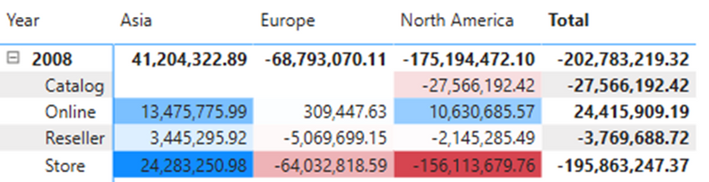
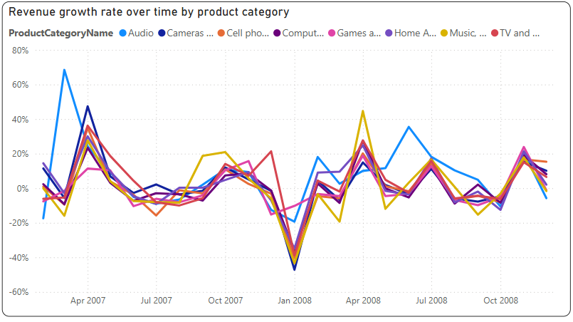
Asia showed positive growth across all channels
Online channel experienced positive growth in all regions
North America saw the biggest decline, losing $175M (71% of the global revenue drop).
Store channel was hit hardest, dropping $156M (-89%).
Catalog, sold only in the USA, declined by $27M.
Online was the only channel with slight growth, increasing by $10M (+5.7%).
Europe followed a similar trend to North America but on a smaller scale, with a revenue drop of $68M.
Store channel saw the largest decline, losing $64M (94% of the region’s total drop).
Online was the only channel with growth, increasing slightly by $309K.
Asia was the only region with revenue growth across all channels, increasing by $41M.
Store saw the highest growth, adding $24M, followed by Online, which grew by $13M.
=> Asia and the Online channel consistently showed positive growth.
Recommendation: Focus on these two areas for future expansion.
Monthly revenue growth trends are similar across all products.
Conclusion: The revenue decline was not caused by specific products.

Slide 10
Conclusion
What caused the decline in revenue?
Key finding:
Revenue and profit declined, not part of a company strategy.
Drop due to fewer orders, despite higher order value.
Lower return rate suggests higher customer satisfaction.
Sharp dip in Q1 2008, then recovery.
Decline across all products, not product-specific.
Revenue fell in North America & Europe, but grew in Asia.
Conclude:
Cause: The 2008-2009 financial crisis, starting in the U.S., was spreading globally.
Asia remained strong, possibly due to delayed impact or effective strategies.
Next step: Analyze regional differences for deeper insights.
Proposed Solutions:
Focus on Asia & Online Channels
Expand into Emerging Markets – Diversify to reduce dependence on North America & Europe.
Enhance Customer Retention – Maintain high satisfaction and reduce churn.
Adapt Pricing & Promotions – Offer competitive pricing to counter declining order volume.
Strengthen Crisis Preparedness – Develop risk management strategies for economic downturns.

Slide 11
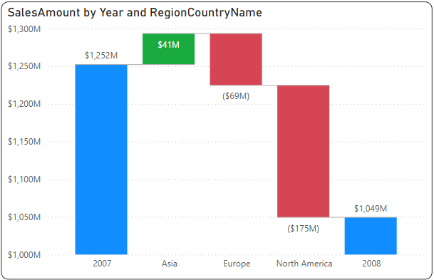
discussion
Why did Asia increase by 41M while Europe and America decreased by more than 220M?

Slide 12
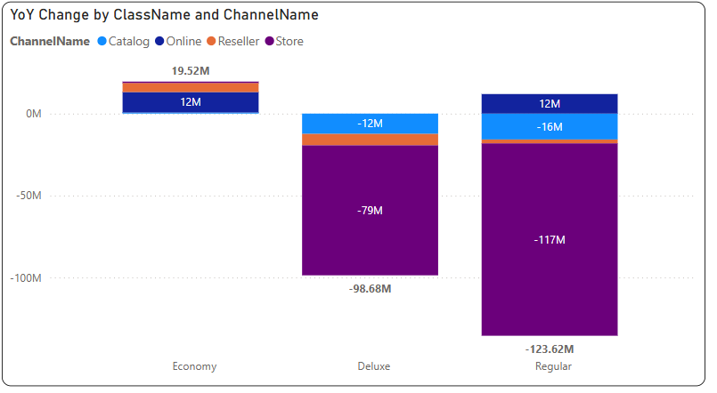


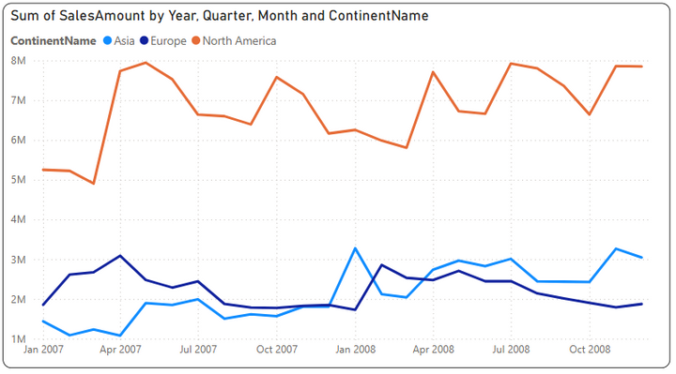
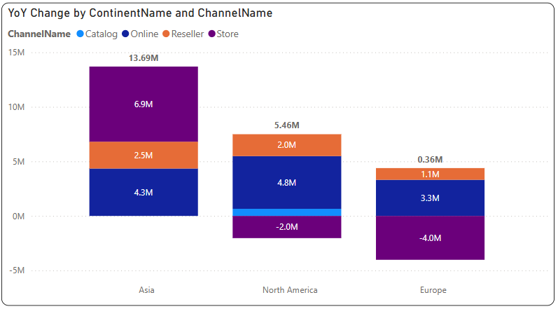
Economy segment grew by $19.5M, mainly driven by Asia (+$13.7M).
The Economy segment grew by 15.67% (+$19.5M) across all regions.
Asia led with a 72% increase (+$13.7M) across all channels.
Europe and North America saw similar growth, but Store sales declined in these regions while increasing in Asia.
=> Need to focus on promoting Online and Reseller channels for this segment in Europe and North America
Revenue over time by region at Store channel

Slide 13

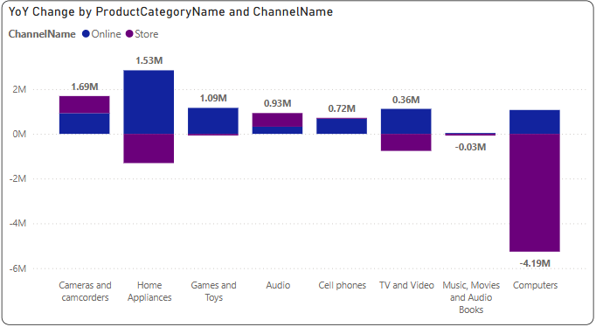

In the Economy segment, stores in Europe and America decreased while Online increased.
Revenue over time by region for Economy segment
Main cause: Shift from Store to Online in Computers, Home Appliances, and TV & Video
(Online sales grew while Store declined).
Games & Toys, Cell Phones were mainly sold online, further boosting 2008 Online sales.
Solution:
Enhance digital strategies to leverage the shift from Store to Online, especially for product categories that are experiencing good revenue growth such as Computers, Home Appliances, and TV & Video for the economy segment
Revenue change over time by product category for Online and Store channels in the European and American markets

Slide 14
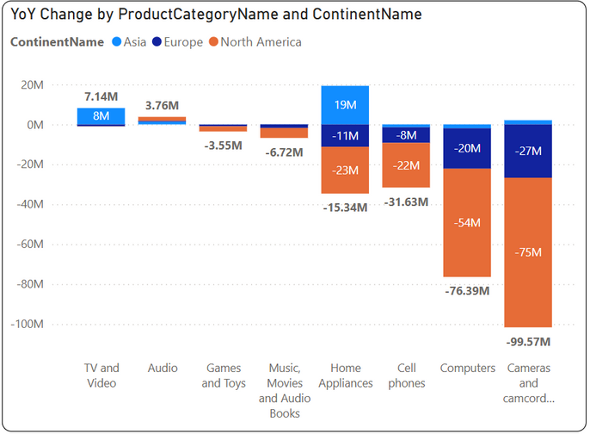
The Deluxe and Regular product segments saw a sharp decline in revenue, mainly from Stores
Deluxe & Regular segments dropped $222M in Europe & North America, while Asia grew by $19M.
Key reason: Home Appliances rose in Asia (+$19M), mainly in Store & Online, while Europe & North America declined (-$34M).
Cell Phones, Computers, and Cameras saw sharp declines in Europe & North America, while Asia maintained growth.
Solution:
Strengthen Home Appliance sales in Europe & North America by adapting successful strategies from Asia.
Expand Online presence for Deluxe & Regular products, following the trend of shifting from Store to Online.
Enhance marketing & promotions for declining categories (Cell Phones, Computers, Cameras) in Europe & North America.
Diversify product offerings in these regions to match consumer demand.

Slide 15
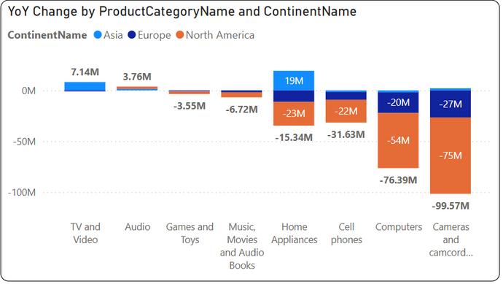
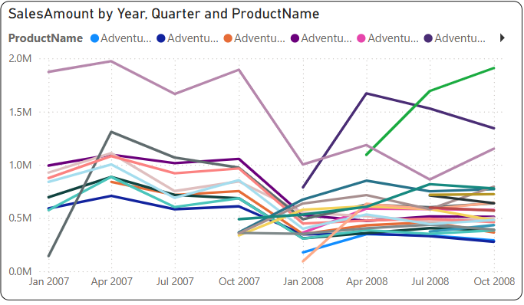


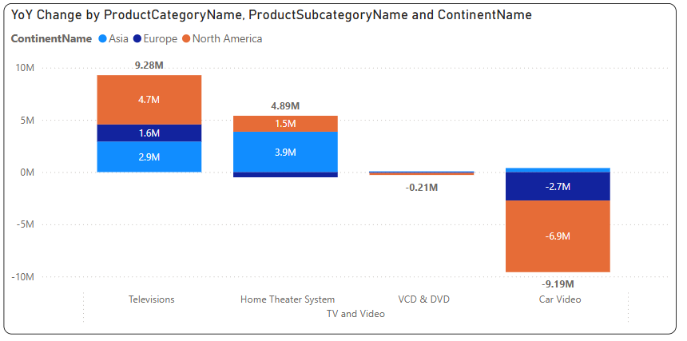
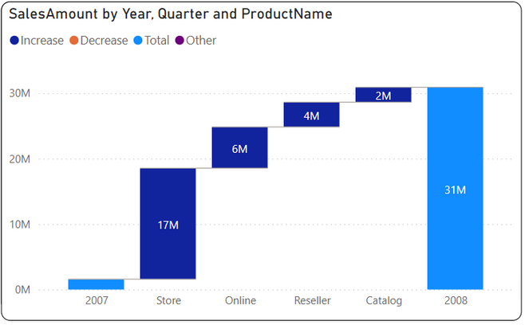
TV and Video was the only product category to grow revenue in 2008, mainly in Asia
TV and Video was the only product line that grew with 4.8M, specifically for home theater systems and TV:
Litware Home Theater System, released in Q1-Q2 2008, boosted category sales.
Most other products declined in 2008, especially in Q1.
=> New product launch was relatively successful.
Newly released Litware products are mostly sold at the Store

Slide 16
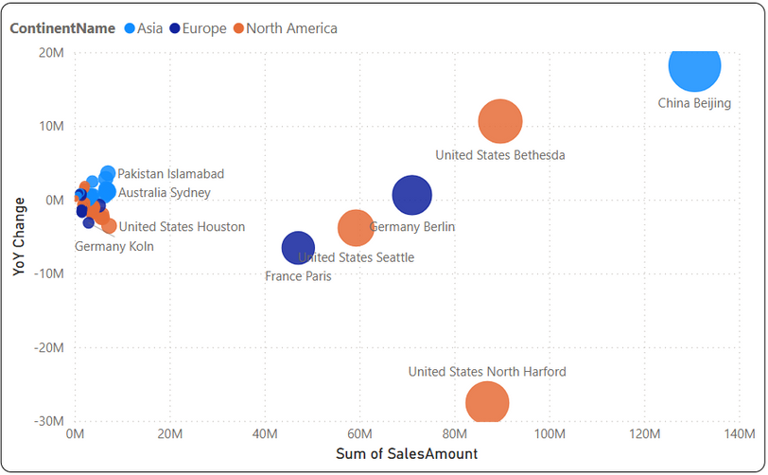
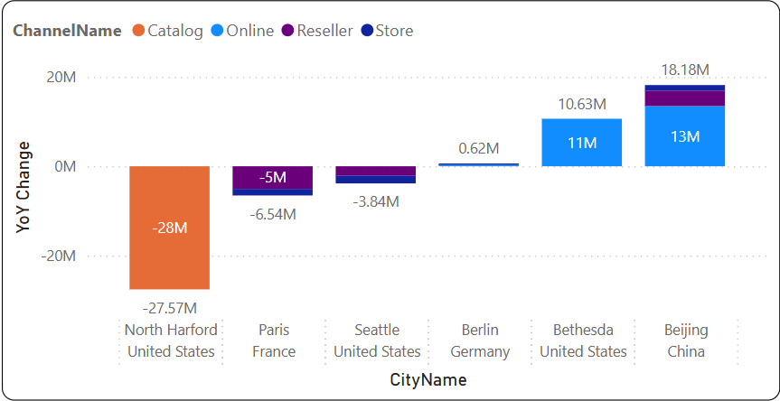
Beijing, China, had the largest revenue increase
North Harford, USA, had the largest revenue decrease
The size of the dots represents revenue in 2008.
Most countries in Asia showed growth.
Most countries in Europe and North America declined.
Beijing, China had the highest revenue growth in 2008 ($18.2M), mainly from Online ($13M) and Reseller ($3.5M) channels.
Paris (France) and Seattle (USA) had moderate sales with smaller declines ($6.5M and $3.8M), mainly decreasing in Reseller and Store channels.
North Harford and Bethesda (both in Maryland) showed a major revenue contrast (+$11M vs. -$28M), due to differences in sales channels (Catalog vs. Reseller).

Slide 17
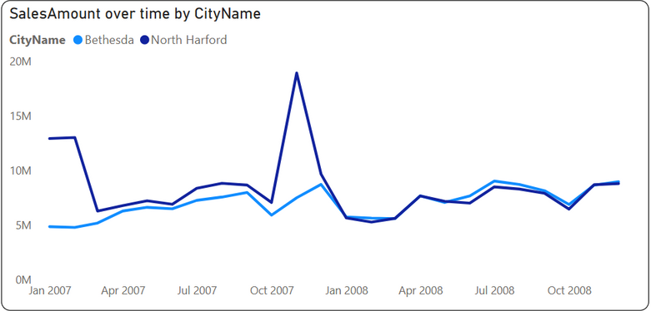
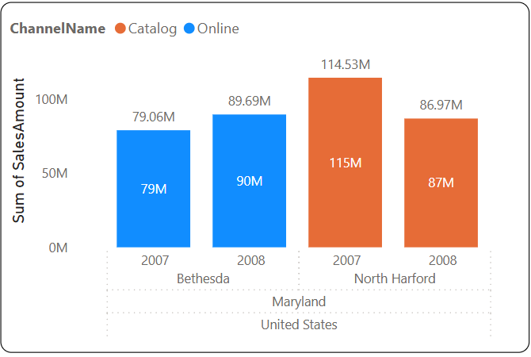
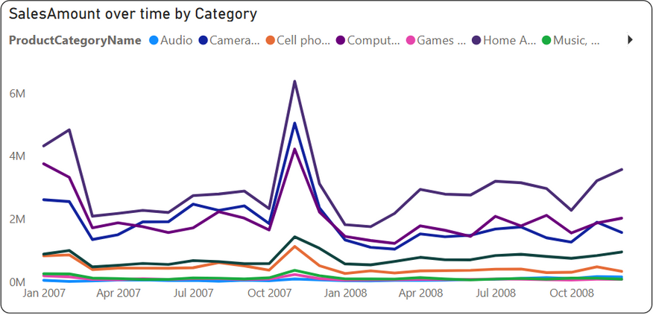
Also in Maryland, there is a big difference in revenue growth between the two cities.
Maryland had the most significant revenue fluctuation due to contrasting trends between two cities:
North Harford declined by $28M (-24.5%), in the Catalog channel.
Bethesda grew by $11M (+13.9%), driven by the Online channel.
Revenue fluctuations in the Catalog channel (North Harford) in Jan, Feb, and Nov 2007 (cause unclear) did not repeat in 2008, leading to a sharp decline. The most affected categories were Home Appliances, Cameras, and Computers.

Slide 18
Conclusion
Solutions to Increase Revenue in Europe and America
1. Expand Online Sales Channels
Shift focus from Store & Catalog to Online, following Asia’s growth trend.
Optimize digital marketing & e-commerce strategies.
2. Adjust Product Strategy
Prioritize Economy segment (growing in all regions).
Promote TV & Video (successful new launches in 2008).
3. Region-Specific Pricing & Promotions
Address economic downturn by offering competitive pricing & seasonal discounts.
Optimize discount strategies based on seasonal demand (Q4 peak, Q2 low).
4. Enhance Customer Retention
Leverage declining return rates to improve loyalty programs.
Offer personalized deals to previous Store & Catalog customers.
5. Analyze & Address Catalog Sales Decline
Investigate Catalog revenue spikes in North Harford (2007) and adjust strategies.
Evaluate Catalog’s viability and consider reinvestment in Online & Reseller channels.

Slide 19
discussion
Which item had the biggest drop in sales in 2008?

Slide 20
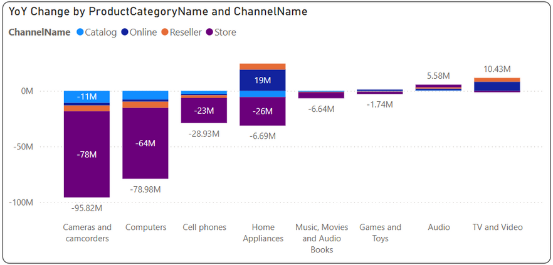



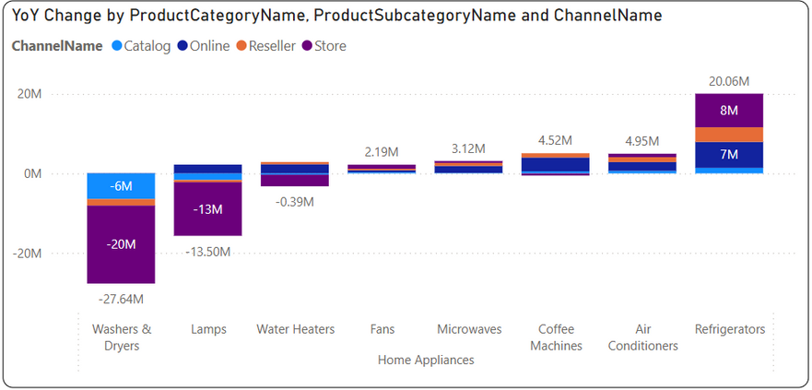

Cameras and Camcorders, Computers, Cell phones had the sharpest declines in revenue
The three biggest revenue declines were in Cameras & Camcorders (-96M), Computers (-79M), and Cell Phones (-29M), mainly from the Store channel.
Home Appliances has a sharp decline in Store and Catalog, but experienced growed in Online and Reseller channel
Refrigerators, Air Conditioners, Coffee, and Microwaves grew strongly (+34M)
=> Focus on these products.
Washers & Dryers and Lamps declined (-27.64M and -13.5M) mainly in Store & Catalog, but Online showed positive signs
=> Shift strategy towards Online.

Slide 21
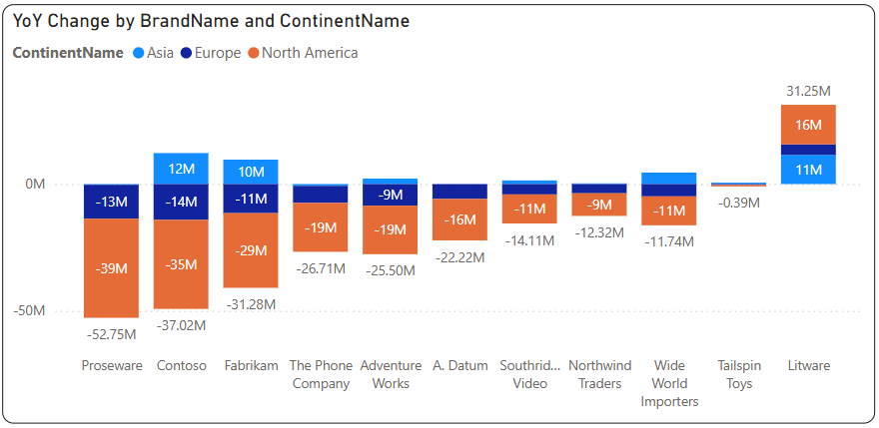
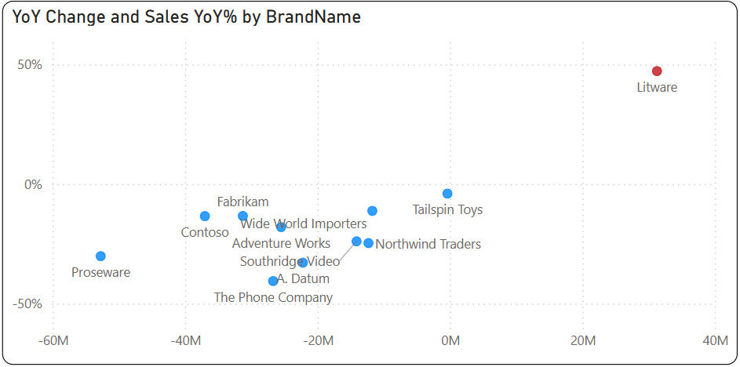
Litware is the only brand with positve revenue growth and the only growing in North America
Litware was the only brand with positive growth, increasing 31.25M (47.2%).
In North America, while most brands saw sharp revenue declines, Litware grew by 16M.

Slide 22
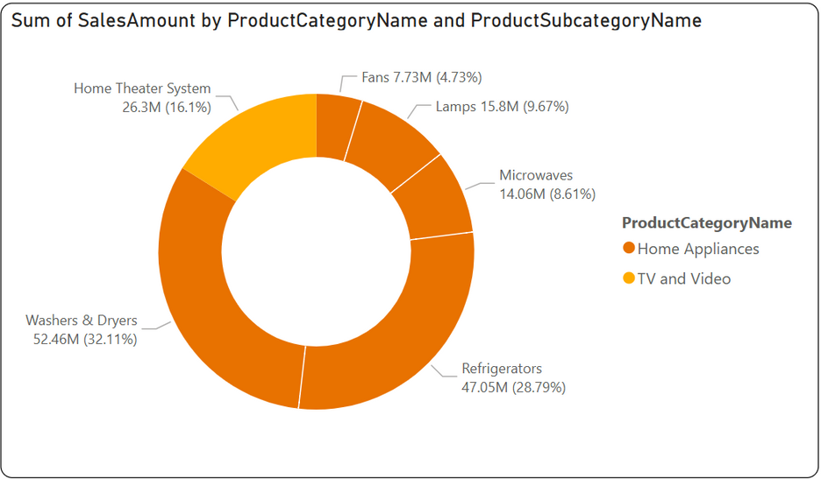
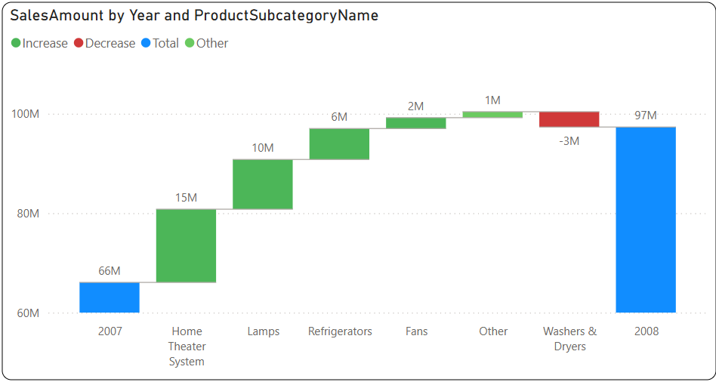
Litware is the only brand with positve revenue growth
Litware sells two product lines:
Home Appliance: 83.9% of revenue (5 subcategories)
TV and Video (specifically Home Theater System): 16.1% of revenue
In Litware’s $31M growth:
Home Theater System: +15M
Lamps: +10M
Refrigerators: +6M
Washers & Dryers: -3M

Slide 23
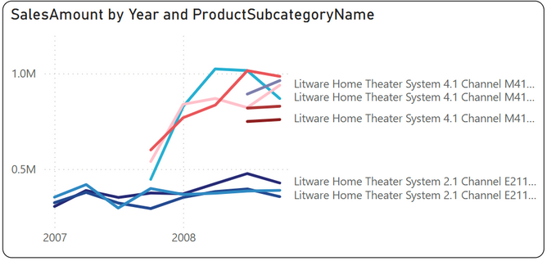
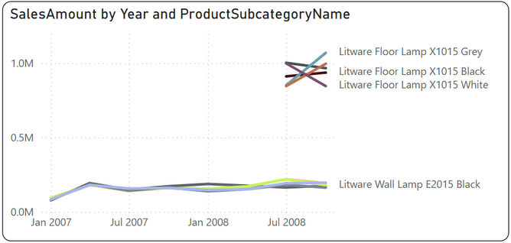
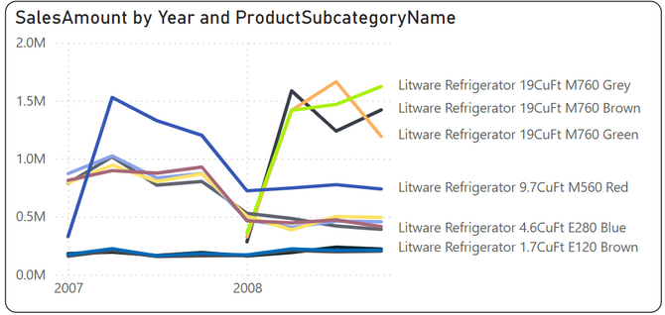
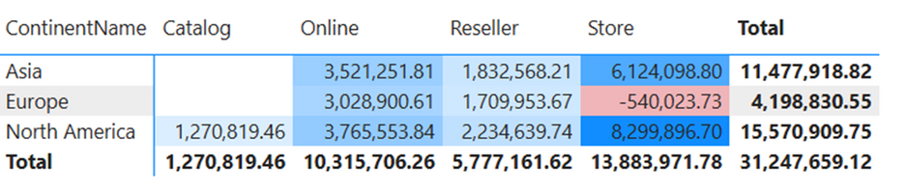
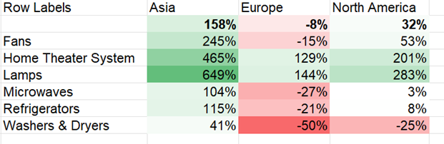
Litware is the only brand with positve revenue growth
Home Theater System (+15M)
Lamps (+10M)
Refrigerators (+6M)
=> Sales growth in 2008 was driven by late product launches.
=> These are new-generation or entirely new products, showing strong market acceptance and high revenue compared to existing products
=> Litware's product lines grew across most channels and regions, with the strongest performance in Asia and North America, particularly in Store and Online.
=> Only the Store channel in Europe saw a decline.
=> Store performance in Europe lags behind other regions across most products.
=> To boost sales, Europe should focus on Online and Reseller channels, emphasizing high-growth products like Home Theater Systems and Lamps.

Slide 24
Summary: Revenue Decline in 2008 & Solutions
Key finding:
1. Overall Sales Decline:
Significant revenue drop in Deluxe and Regular product segments (-222M), mainly in Europe & North America, while Asia grew (+19M).
Cameras & Camcorders (-96M), Computers (-79M), and Cell Phones (-29M) saw the largest declines, mostly in Store channels.
Home Appliances sales dropped in Store & Catalog, but showed growth in Online & Reseller channels.
2. Geographical Trends:
Asia saw positive growth across all channels.
Europe & North America experienced heavy losses, with Europe’s Store sales being the weakest.
Maryland (USA) had the most volatile revenue shift due to irregular Catalog sales fluctuations in 2007, leading to a sharp drop in 2008.
3. Brand Performance – Litware Stands Out:
The only brand with positive growth (+31.25M, +47.2%), driven by Home Theater Systems (+15M), Lamps (+10M), and Refrigerators (+6M).
Strongest growth in Asia & North America, mainly in Store & Online channels.
European Store sales declined, despite overall success.

Slide 25
Summary: Revenue Decline in 2008 & Solutions
Proposed Solutions:
3. Regional Sales Strategy
Asia: Maintain growth momentum across all channels.
Europe & North America: Improve Online & Reseller sales to offset Store declines.
Europe: Strengthen focus on high-growth products (Home Theater Systems & Lamps).
Maryland, USA: Study of sales fluctuations by sales channel.
4. Leverage Litware’s Successful Model
Expand high-performing product categories (Home Theater Systems, Lamps, Refrigerators).
Apply new product launch strategies across struggling segments to drive demand.
1. Shift Focus to Online & Reseller Channels
Reduce reliance on Store & Catalog, which saw the most significant losses.
Boost digital marketing & e-commerce presence to capture shifting consumer behavior.
2. Product & Pricing Strategy Adjustments
Revamp underperforming products like Cameras, Computers, and Cell Phones.
Offer competitive pricing, promotions, and bundling to boost demand.

